Slide 1
MATLAB ASSIGNMENT 5
GROUP 8

Slide 2
MATLAB ASSIGNMENT QUESTION
On implementing the concept of class, encapsulation, inheritance, polymorphism and abstraction. Develop and paste a high end (level) back-end implementation of the numerical methods application for solving computational problems for simplicity and applying the code developed in the previous assignment and ensure that the apparent class holds all abstract methods with two sub classes, one for differential problems and the other for integral problems.

Slide 3
Step by step implementation
This approach implements and defines the abstract interface for all numerical problems while as It holds the core properties and the abstract solve method that every subclass must implement.
The MATLAB code is given by:
classdef (Abstract) NumericalProblem < handle
% NUMERICALPROBLEM Abstract base class for numerical methods.
properties (Access = protected)
% Encapsulated properties for the problem definition
func; % Function handle to the mathematical function
params; % Optional parameters for the function
end

Slide 4
methods
function obj = NumericalProblem(func, params)
% Constructor to initialize the function and parameters
obj.func = func;
obj.params = params;
end
end
methods (Abstract)
% Abstract method for solving the problem. Subclasses must implement this.
result = solve(obj);
end

Slide 5
end
methods (Abstract)
% Abstract method for solving the problem. Subclasses must implement this.
result = solve(obj);
end
methods (Access = protected)
% Encapsulated helper method to validate the function handle
function validateFunction(obj)
if ~isa(obj.func, 'function_handle')
error('The function provided must be a function handle.');
end
end
end
end

Slide 6
DEFINING A DIFFERENTIAL SUBCLASS (differential solver)
matlab code
classdef DifferentialSolver < NumericalProblem
% DIFFERENTIALSOLVER Solves ordinary differential equations using Euler's method.
properties (Access = private)
% Private properties specific to differential problems
tspan; % [t_start, t_end]
y0; % Initial condition
h; % Step size
end

Slide 7
methods
function obj = DifferentialSolver(func, tspan, y0, h)
% Constructor for a differential problem
obj = obj@NumericalProblem(func, []); % Call superclass constructor
obj.tspan = tspan;
obj.y0 = y0;
obj.h = h;
obj.validateFunction(); % Use inherited validation method
end
function [t_out, y_out] = solve(obj)
% Implement the Euler's method
t_start = obj.tspan(1);

Slide 8
t_end = obj.tspan(2);
t_out = t_start:obj.h:t_end;
n_steps = length(t_out);
y_out = zeros(size(t_out));
y_out(1) = obj.y0;
for i = 1:(n_steps - 1)
y_out(i+1) = y_out(i) + obj.h * obj.func(t_out(i), y_out(i));
end
% Plot the result (optional for visual testing)
figure;
plot(t_out, y_out, '-o');
title('Solution of ODE using Euler''s Method');

Slide 9
xlabel('t');
ylabel('y');
end
end
end

Slide 10
DEFINING INTEGRAL CLASS. (Integral solver.m)
matlab code
classdef IntegralSolver < NumericalProblem
% INTEGRALSOLVER Solves definite integrals using the trapezoidal rule.
properties (Access = private)
% Private properties specific to integral problems
a; % Lower bound
b; % Upper bound
n; % Number of intervals
end

Slide 11
methods
function obj = IntegralSolver(func, a, b, n)
% Constructor for an integral problem
obj = obj@NumericalProblem(func, []); % Call superclass constructor
obj.a = a;
obj.b = b;
obj.n = n;
obj.validateFunction(); % Use inherited validation method
end
function integral_result = solve(obj)

Slide 12
% Implement the trapezoidal rule
h = (obj.b - obj.a) / obj.n;
x = obj.a:h:obj.b;
y = obj.func(x);
integral_result = h * (0.5 * y(1) + sum(y(2:end-1)) + 0.5 * y(end));
% Display the result
fprintf('Integral from %f to %f is: %f\n', obj.a, obj.b, integral_result);
end
end
end

Slide 13
TESTING THE IMPLEMENTATION ( creating a separate script eg test numerical app.mat
% test_numerical_app.m
% --- Test the DifferentialSolver subclass ---
fprintf('--- Testing DifferentialSolver (Euler''s Method) ---\n');
% Define the ODE: dy/dt = -2t*y
ode_func = @(t,y) -2*t.*y;
tspan_ode = [0, 2];
y0_ode = 1;
h_ode = 0.1;
% Create an object of the DifferentialSolver class
diff_problem = DifferentialSolver(ode_func, tspan_ode, y0_ode, h_ode);

Slide 14
% Solve the differential problem using the polymorphic 'solve' method
[t_sol, y_sol] = diff_problem.solve();
% The analytical solution is y(t) = exp(-t^2)
y_exact = exp(-t_sol.^2);
% Plot the numerical and analytical solutions for comparison
hold on;
plot(t_sol, y_exact, 'r-', 'LineWidth', 2);
legend('Euler Method', 'Exact Solution');
hold off;
fprintf('Differential problem solved. Plot generated.\n\n');
% --- Test the IntegralSolver subclass ---
fprintf('--- Testing IntegralSolver (Trapezoidal Rule) ---\n');

Slide 15
% Define the function to integrate: f(x) = x^2 from 0 to 1
integral_func = @(x) x.^2;
a_int = 0;
b_int = 1;
n_intervals = 100;
% Create an object of the IntegralSolver class
int_problem = IntegralSolver(integral_func, a_int, b_int, n_intervals);
% Solve the integral problem using the polymorphic 'solve' method
integral_result = int_problem.solve();
% The analytical solution is 1/3
fprintf('Expected integral result is 0.333333...\n');

Slide 16
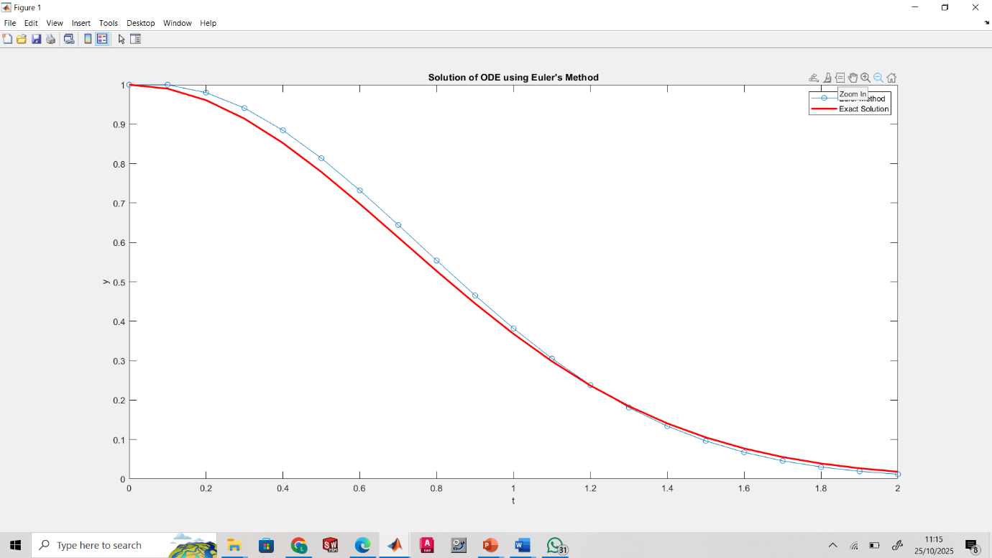
The graph

Slide 17
CONCLUSSION
The command window will display the integral result, and a figure window will pop up showing the Euler's method approximation alongside the exact solution for the differential equation, demonstrating the encapsulation, inheritance, and polymorphic behaviour of the classes.

